Slide 1
Requirement Engineering
Prof. Dr. Shazia Shoaib

Slide 2
Non-Functional Requirements

Slide 3
Non-Functional Requirements
Performance attribute Quality attributes Efficiency attribute
Time, reliability, security, maintainability are the non-functional requirements.
Non-functional requirements are the emergent behavior of the system, which mean it is collective behavior of the attributes or characteristics.
Non-functional requirements are more critical and important.

Slide 4
When gather non-functional requirements make them the part of the software architecture. If non-functional requirements not add before it is difficult to add later on. Add non-functional requirements carefully and timely.
It is difficult to add reliability in unreliable software, security in unsecure system.

Slide 5
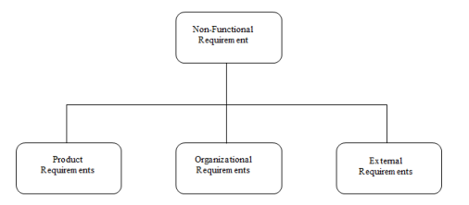
Non-Functional Requirement

Slide 6
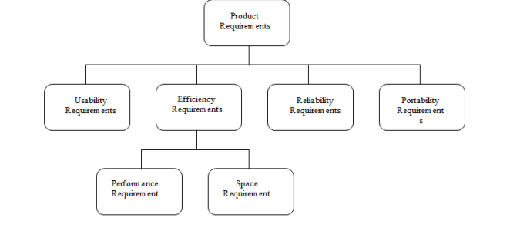
Product Requirements

Slide 7
Usability requirements
User interface of product
Interaction of the product to other product
For example:
Navigation and Menu Consistency

Slide 8
Efficiency Requirement
Deal with performance issues,
Hard disk and space issues,
Memory management issues

Slide 9
Reliability
Reliability is concern with product clarity and user expectation.
For example:
If as air-craft not meet reliability standards, then no certificate of safe of flying given. It is not the important function of flying but the in non-functional requirements reliability is important.

Slide 10
Portability requirements
Put constraints on software to make it portable on different platform. These platform can be operating system can be different kind of hardware, different kind of process, different kind of language compiler.
For example:
Cross-Platform Compatibility

Slide 11
Organizational
Requirements
Standard
Implementation
Delivery

Slide 12
Organizational Requirements
Standard Requirements
Deal with different type of software development in IT standards that are followed by companies.
Military standard (The system development process and deliverable documents shall conform to the MILSTD-2167A)
Commercial standards
Implementation Requirements
Certain implementation aspects (design methodologies) of the software. E.g, requirements say product developed using dot net framework.
Delivery Requirements
Specific criteria and expectations that must be met when delivering products, services, or projects within the organization.
Essential for ensuring that work is completed efficiently, effectively.
Check whether deliver product on web, CDs, hard disk etc.

Slide 13
Example
Any development work sub-contracted by the development organization shall be carried out in accordance with Capability Maturity Model (CMM).
CMM is a standard developed by software engineering institute USA.

Slide 14
External
Requirements
Interoperability
Ethical
Legislative
Privacy
Safety

Slide 15
External Requirements
Interoperability requirements
Describe characteristics of systems (always interoperate together) whose interface completely understand to work with other system at present or future, without any restriction.
e.g, if existing product use old techniques new developer should interoperate new technologies with old products.
Ethical requirements
Deal with culture of country, customers or company.
Establishment of the code of ethics by IEEE of computing machinery.
Legislative requirements
Legal requirements, laws and regulation that organization comply with stakeholders. E.g, Tax law.
Privacy
Safety

Slide 16
Privacy
Privacy: Privacy, is the state of being free from unauthorized intrusion or observation. It pertains to the control and protection of personal information, thoughts, and activities, with an emphasis on autonomy and confidentiality.
For Example:
These laws, such as the GDPR and CCPA, govern the collection, processing, and protection of personal data. Organizations are required to obtain explicit consent for data processing, provide data subjects with rights over their data, and implement security measures to safeguard data.
Like hospital not allowed to disclose patients' personal details to anyone.
European Union's General Data Protection Regulation (GDPR)
California Consumer Privacy Act (CCPA)

Slide 17
Safety
Safety: Safety refers to the condition of being protected from harm, danger, or risk. It encompasses physical, emotional, and psychological well-being and focuses on preventing accidents, injuries, or threats to health and life.
For example:
Occupational health and safety regulations, like the (OSHA) in the United States, set standards for workplace safety. Organizations must provide a safe working environment, conduct safety training, and implement protocols to prevent accidents and injuries.
Occupational Safety and Health Administration (OSHA)

Slide 18
Examples of external requirements
The system shall not disclose any personal information about members of the library system to other members except system administrators.
The system shall comply with the local and national laws regarding the use of software tools.

Slide 19
Observations on Non-Functional Requirements
Non-functional requirements can be written to reflect general goals(expressed in quantitative measures) for the system. E.g, rapid user response, ease to use.
Objective verification is difficult (maintainability is difficult)
Goals are open to misinterpretation
Distinction between functional and non-functional is not always very clear
Chance of conflict
in stakeholders and
developers.
Priorities given by
development team to
negotiate with stakeholders

Slide 20
Observations on Non-Functional Requirements
Chances of conflicts within non-functional requirements are high, because information is coming from different stakeholders. For example, different stakeholders can give different response times or failure tolerance levels, etc.
Some negotiations must be done among different stakeholders, to achieve an agreement in these situations
Not domain experts
Requirement engineers should
consult with stakeholders.

Slide 21
Summary
Non-functional requirements as a whole impact on the software product.
It is more impacted than individual requirement.
If non-functional requirements not involved in product. Then product will not be able to use.
E.g, if as air-craft not meet reliability standards then no certificate of safe of flying given. It is not the important function of flying but the in non-functional requirements reliability is important.

